Slide 1
Twenty Centuries A Survey of Church History
Pastor Rick Phillips
Second Presbyterian Church, Greenville, SC
The First Century

Slide 2
Twenty Centuries
Bibliography:
History of the Christian Church, 8 vols., Philip Schaff
Heroes & Heretics: Pivotal Moments in 20 Centuries of the Church, Iain D. Campbell
Turning Points: Decisive Moments in the History of Christianity, Mark A. Noll
2000 Years of Christ’s Power, 3 vols., N.R. Needham
In the Year of Our Lord: Reflections on Twenty Centuries of Church History: Sinclair B. Ferguson
5 Minutes in Church History, Stephen J. Nichols
Sketches from Church History, S. M. Houghton

Slide 3
The First Century
Life and Ministry of Jesus Christ (4 BC – 28/30 AD)
Church founded in Jerusalem/Scattered by Persecution (30 – AD)
Paul’s Missionary Journeys/ Founding of Gentile Church (49-64 AD)
Fall of Jerusalem (70 AD)
Writing of New Testament (50-95 AD)
Onset of Roman Persecution (63, 95 AD)

Slide 4
1. Life and Ministry of Jesus Christ (4 BC-28/30 AD)
God’s Son Born as Man (4-6 BC)
“She will bear a son, and you shall call his name Jesus, for he will save his people from their sins” (Mt. 1:21).
Redeeming Work of God Accomplished
“Christ died for our sins in accordance with the Scriptures, that he was buried, that he was raised on the third day in accordance with the Scriptures, and that he appeared to Cephas, then to the twelve” (1 Cor. 15:3-5).
Calling/Training of First Disciples
“He said to them, ‘Follow me, and I will make you fishers of men” (Mt. 4:19).

Slide 5
Life and Ministry of Jesus Christ (4 BC-28/30 AD)
Teaching of the Kingdom of God
“He went throughout all Galilee, teaching in their synagogues and proclaiming the gospel of the kingdom and healing every disease and every affliction among the people” (Mt. 4:23).
Ascension into Heaven / Outpouring of the Holy Spirit.
He said to them, “It is not for you to know times or seasons that the Father has fixed by his own authority. But you will receive power when the Holy Spirit has come upon you, and you will be my witnesses in Jerusalem and in all Judea and Samaria, and to the end of the earth.” And when he had said these things, as they were looking on, he was lifted up, and a cloud took him out of their sight” (Acts 1:7-9).
Result: Original church founded, with apostles, in Jerusalem (appr. 30 AD).

Slide 6
Church Founded and Scattered (30-48 AD)
Original Context of the Church
Jewish foundation
Roman Political World
Greek Thought Life
Early Growth / Initial Pattern
Worship centered on Teaching & Prayer
“And they devoted themselves to the apostles’ teaching and the fellowship, to the breaking of bread and the prayers” (Acts 2:42).
Apostolic Miracles and Authority (Heb. 2:3-4).
Church Organization: Originally apostles and deacons (Acts 6).

Slide 7
Church Founded and Scattered (30-48 AD)
Persecution and Spread
Early Evangelistic Outreach (Philip in Samaria)
Stoning of Stephen (32 AD?)
Conversion of Saul of Tarsus (33 AD)
Persecution by Herod and the Pharisees (33-44 AD)
Flight of Christians/ Spread of Gospel
Jesus’ interventions & encouragement of evangelism (Acts 18:9)
Result: Church overseen by apostles, ruled by Christ; spread by persecution (new center in Antioch); power of the Holy Spirit experienced.

Slide 8
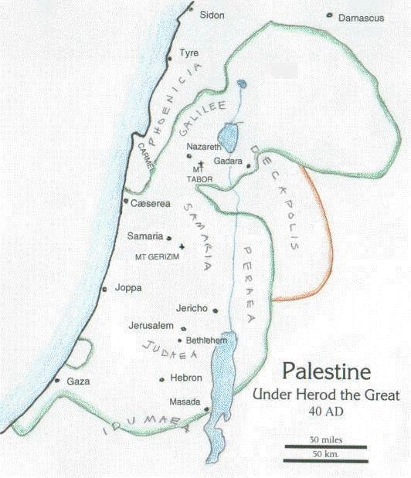
Palestine in the First Century AD

Slide 9
Paul’s Missionary Journeys (33-64 AD)
Initial Journeys: Arabia, Syria, and Cilicia (Acts 9, 22; Gal. 1; 33-43 AD).
Converted in Damascus, preaching in synagogues (Acts 9:19-22)
Flees to Jerusalem; told by Jesus to flee to Tarsus (Acts 22:17-21)
Three Year Evangelistic ministry in Arabia (Gal. 1:17)
Brief return to Damascus? 15 day visit to Jerusalem, meets apostle James (Gal. 1:18-19).
Departure for northern Syria and Cilicia (Gal. 1:21).
Sought by Barnabus in Tarsus to join Antioch church (Acts 11:25-26).
“First” Journey: From Antioch to Crete (Acts 13-14; 44-46 AD)
Paul & Barnabas set apart by the Holy Spirit (Acts 13:1-3).
Mission to Southern Galatia and Cyprus
Opposition from “magicians” and false prophets (Acts 13:6-12)
Preaching in synagogues and mass evangelism (Acts 13:13-14:23).
Council of Jerusalem (Acts 15; 49AD)
“Problem” of Gentile Churches
Clarification of Justification through Faith Alone

Slide 10
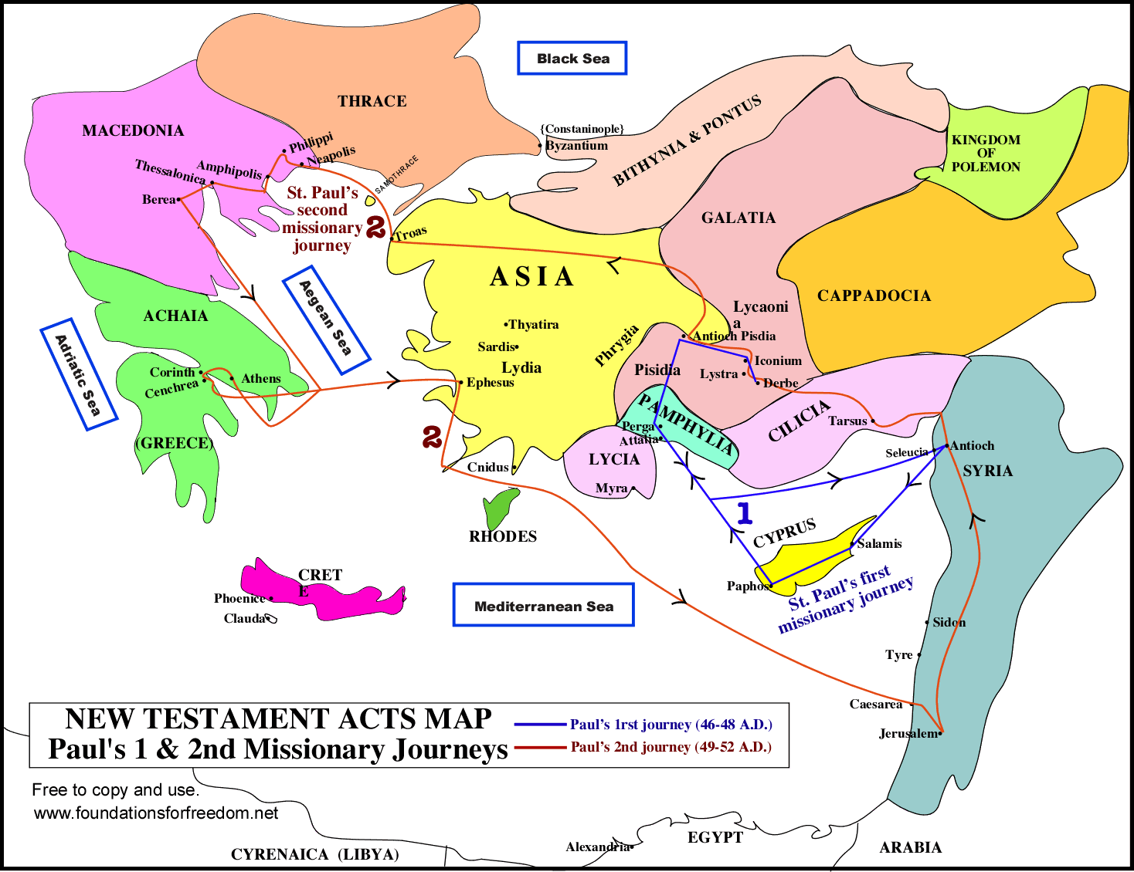
Paul’s Missionary Journeys

Slide 11
Paul’s Missionary Journeys (33-64 AD)
Second Journey: Through Turkey & Greece (Acts 15-18; 49-52 AD)
Visit to Galatian Churches
Founding of Philippian, Thessalonian, and Corinthian Churches (Acts 16-18)
First Pauline Letters (Galatians / Thessalonians)
Third Journey: Back through Churches/ To Rome (Acts 19-20; 53-59 AD)
Founding of Ephesian Church (Acts 19); Visit to Macedonia and Greece (Acts 20)
Letters to Romans, Corinthians
Offering for Relief of Jerusalem Church / Arrest in Jerusalem / Witness to Rulers (Acts 21-22)
Paul in Rome (Acts 21-28; 60-64 AD)
First Imprisonment / Prison Letters (60-61 AD)
Release and Re-Arrest / 1 Timothy & Titus (62-63 AD)
Second Imprisonment / Witness to Caesar / 2 Timothy (63-64 AD)
Death of Paul AD 64
Result: Church Spread throughout Mediterranean
Jew and Gentile Church outside of Jerusalem
Diffusion of Leadership
Emphasis on Local Elder Rule, under Apostolic Authority
Doctrinal Foundation

Slide 12
The Fall of Jerusalem (70 AD)
The End of Pharisaical Judaism
Jerusalem political establishment destroyed
Second Temple destroyed
Jesus’ prophecy of judgment fulfilled (Mt. 24:1-2; Lk. 21:5-9)
Flight of the Christians
Jesus’ warning heeded (Mt. 24:15-22; Lk. 21:20-24)
Jerusalem no longer capital / Jewish tie severed
End of Jewish protection in Roman Empire

Slide 13
Writing of the New Testament
Apostolic Epistles written
Situational focus
Provide doctrinal clarity
Ecclesiastical foundation
Gospels Recorded
Oral tradition captured
Apostolic witness to life and ministry of Jesus (Matthew; Mark (Peter?); Luke (Paul?); John).
Conflict with Heresy
Justification conflict with Judaisers (Paul)
Early struggle vs. Gnosticism (John / Paul)
Other doctrinal struggles (Hebrews; 2 Peter/Jude; 1 Cor. 15, etc.)
Result:
Churches committed to known canon of NT Scripture
Finished apostolic witness as foundation for church

Slide 14
Roman Persecution
Christians initially protected by Jewish status
Jews a favored people, this status lost in struggle with Jews
Claudian Persecution (49 AD)
Post-AD 70, no protection
Nero’s persecution in Rome (64 AD)
Scapegoat for great fire
Apostles Peter and Paul martyred?
Hundreds of Christians tortured and killed
Persecution by later Emperors
Domitian (81-96 AD): Imperial cult / John exiled to Patmos / persecution ended with his death
Trajan (98-117 AD): Imperial cult / fear of secret societies / Christianity outlawed
Apocalyptic Vision of John (95 AD)
Result: Organized church going underground
Combination of persecution and heresy causing church to shift from presbyterianism to episcopalianism.
Threat to Christians and Scriptures
Full canon not received or recognized

Slide 15
Major Changes in the First Century
Judaism gives way to Christianity as New Covenant in Christ is inaugurated
God’s Covenant People expands:
Enthnically: Jews and Gentiles
Geographically: throughout Mediterranean
Culturally: Jewish to Graeco-Roman context
Apostolic Witness to Jesus Christ
New Testament fulfills Old Testament expectation
Biblical doctrine brought to completion
Church learning to cope with heresy and persecution
Shifts in church structure: apostolate – presbyterianism – episcopacy
Response to heresies/ canonization of Scripture begun

